Slide 1
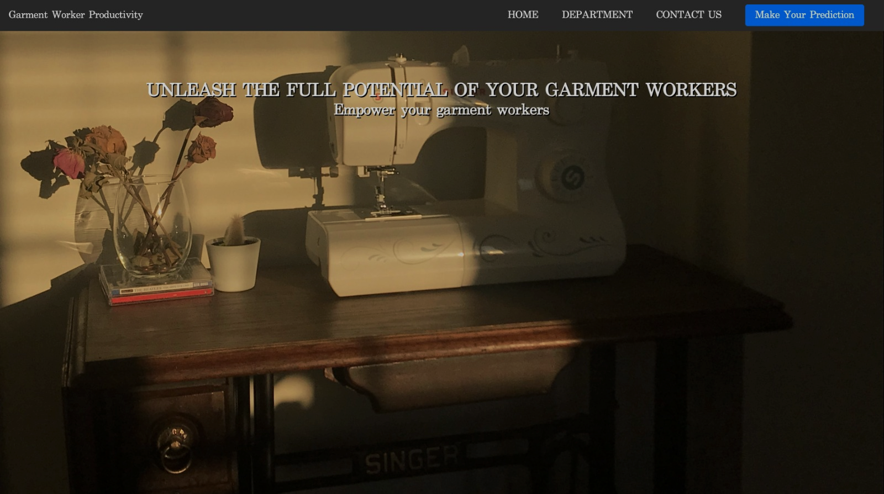
Garment Worker Productivity Prediction using Machine Learning

Slide 2
Team Details
Team Number: 592545
21BCE0440 - Rohan RAI
21BCE0484 - SHIVANI DASh
21BCE0821 - SHREYA GUPTA
21BCE3204 - KASHISH JAIN

Slide 3

Introduction
The garment industry is one of the largest industries in the world, and garment worker
productivity is a crucial factor in determining the success and profitability of a company. In
this project, we aim to develop a machine learning model that predicts the productivity of
garment workers based on a given set of features. Our dataset contains information on
various attributes of garment production, including the quarter, department, day, team
number, time allocated, unfinished items, over time, incentive, idle time, idle men, style
change, number of workers, and actual productivity. We will use this dataset to train and
evaluate our predictive model.
The development of an accurate garment worker productivity prediction model using
machine learning can have significant implications in various domains, including
manufacturing, human resources, and supply chain management. This model can help
companies identify the factors that affect worker productivity and take corrective actions to
improve efficiency, reduce costs, and enhance their competitiveness in the market.

Slide 4

Technologies used:
ML Concepts:
Linear Regression
Decision Tree Regressor
Random Forest Regressor
Gradient Boosting Regressor
Xtreme Gradient Boost Regressor
Bagging Regressor
Boosting Regressor
Flask
HTML , CSS and Java Script

Slide 5

Unlocking Garment Production Secrets: The Crucial Need for Predictive Productivity Magic
Delving into the vast garment industry, our project focuses on creating a machine learning model to predict garment worker productivity. Using a rich dataset covering aspects like quarter, department, day, team, time allocation, and more, we aim to train a model for accurate predictions. This predictive tool holds the key to revolutionizing manufacturing, human resources, and supply chain management. By uncovering factors influencing productivity, companies can take strategic actions to boost efficiency, cut costs, and elevate their competitive edge.

Slide 6
Social and Business Impact
Social Impact: The garment worker productivity prediction model holds the potential to positively impact the lives of garment workers. By identifying the factors influencing worker productivity, the model can pave the way for fair and efficient workforce management practices. It can recommend improvements in working conditions, incentive programs, and training initiatives, resulting in a more satisfying work experience for garment workers. This, in turn, can lead to better compensation, enhanced working conditions, and overall improved job satisfaction among the workforce.
Business Impact: The implications of the garment worker productivity prediction model are substantial for the garment manufacturing industry. The model serves as a catalyst for optimizing workforce management strategies, efficiently reducing idle time, and boosting overall productivity. The resulting benefits are higher profitability, lower production costs, and superior product quality. Moreover, the model aids in pinpointing areas ripe for process enhancement, such as reducing rework and streamlining supply chain operations, contributing to a more competitive and efficient manufacturing landscape.

Slide 7
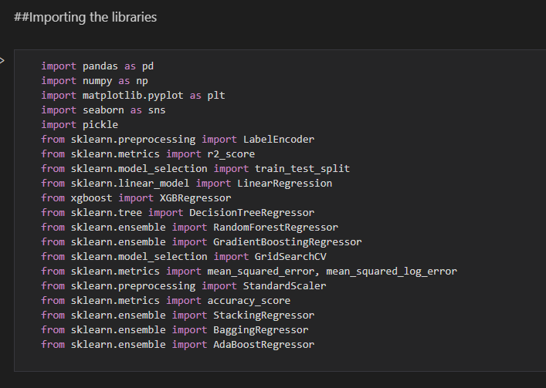
Libraries used
pandas
NumPy
matplotlib
seaborn
sk-learn
pickle
xgboost

Slide 8
Data Preprocessing
Handling Missing Values: We can figure out what kind of data is in our columns by using df.info(). We can count the number of missing or null values and replace them with the column mean.
Handling Independent Columns: Extract the numerical part from the quarter column then replace the original column with the modified one.
Handling Categorical Values: LabelEncoder() object is used to convert the original values into numerical encoded values.

Slide 9
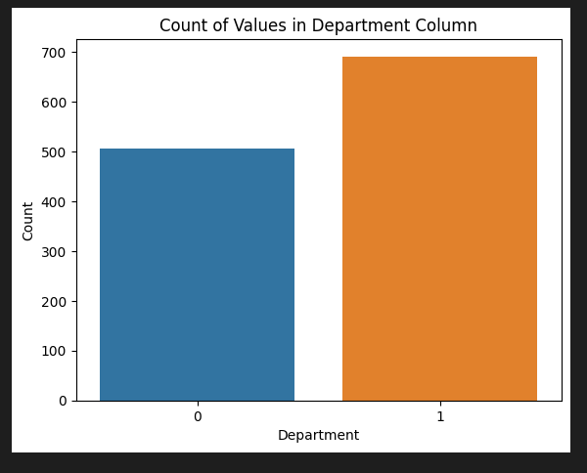
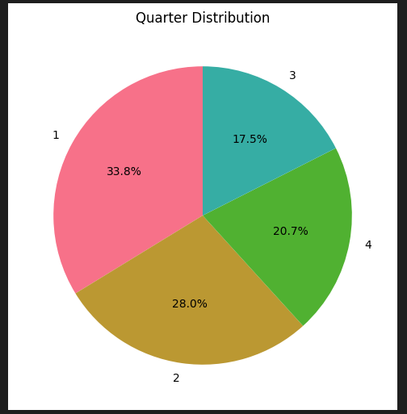
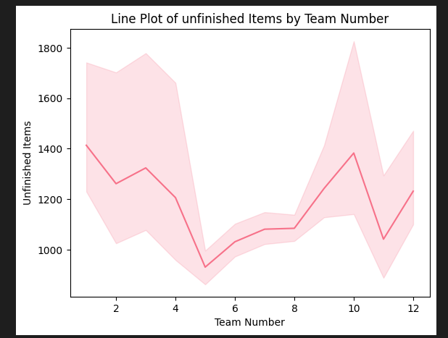
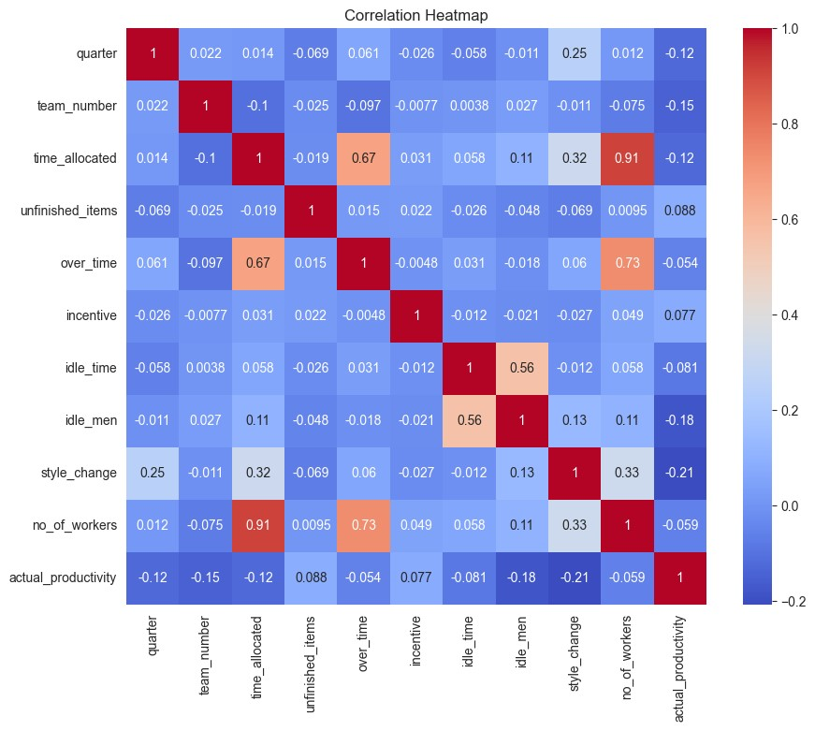
Exploratory Data Analysis
Univariate analysis
Bivariate analysis
Multivariate analysis

Slide 10
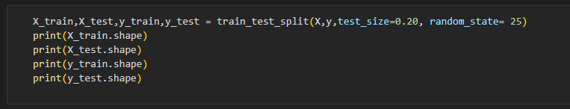
Splitting data into Train and test
Split the Dataset into train and test sets. First split the dataset into X and y
and then split the data set. The ‘X’ corresponds to independent features and ‘y’
corresponds to the target variable.

Slide 11

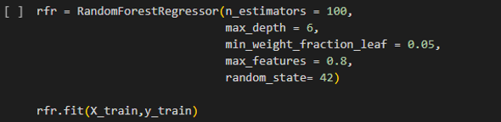
Model Building
Training the model
Linear Regression Model:- This method trains the model by finding the coefficients for the linear equation that best fits the data.
Decision Tree Regressor Model: This model will be able to make predictions on new data based on the relationships learned from the training data.
Random Forest Regressor Model: This model can then be used to make predictions on new data.

Slide 12
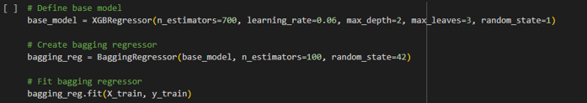
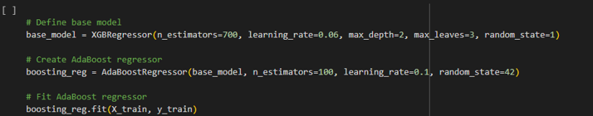
Gradient Boosting Regressor Model: This model can then be used to make predictions on new data using the predict() method.
Extreme Gradient Boost Regressor Model: This model can be used to make predictions on new data.
Bagging Regressor Model: This the model is trained using a set of input data (X_train) and the corresponding target values (y_train). This involves adjusting the weights of the various components of the model until it can accurately predict the target values based on the input data.
Boosting Regressor Model: This model is trained using a set of input data (X_train) and the corresponding target values (y_train). This involves adjusting the weights of the various components of the model until it can accurately predict the target values based on the input data.

Slide 13
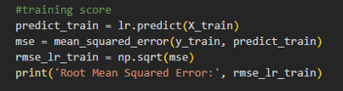
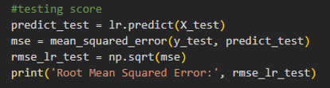
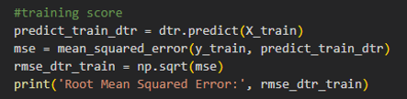
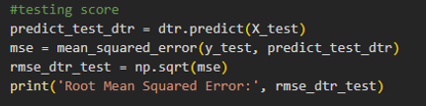

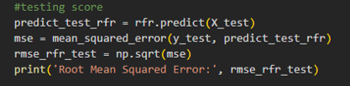
Performance Testing
Linear Regression Model
Decision Tree Regressor Model
Random Forest Regressor Model

Slide 14

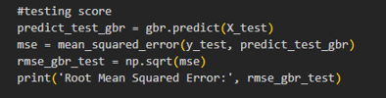
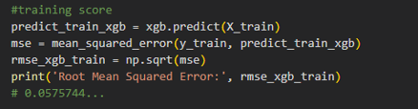

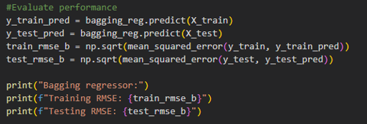
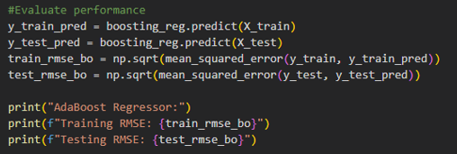
Gradient Boosting Regressor Model
Extreme Gradient Boost Regressor Model
Bagging Regressor Model
Boosting Regressor Model

Slide 15
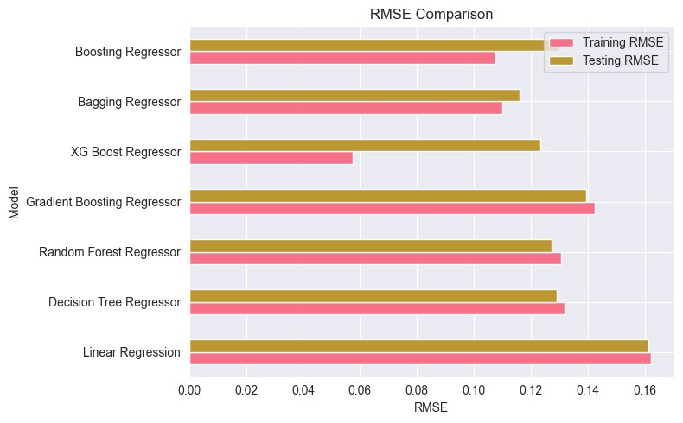
Comparing models
To determine which model is best, we should look for the model with the lowest RMSE value on the test data. This suggests that the model predicts value closer to the actual values. In this out of the seven models selected Boosting Regressor satisfies the conditions and hence selected.

Slide 16
Model Deployment
Save the best model: This code uses the "pickle" library in Python to save the trained Boosting Regressor model named "boosting_reg" as a file named "productivity.pkl". The "dump" method from the pickle library is used to save the model object in a serialized form that can be used again later. The "wb" parameter indicates that the file should be opened in binary mode to write data to it.
Integrate with Web Framework:
Building HTML pages
Building server side script
Run the web application

Slide 17
THANK YOU

